Slide 1
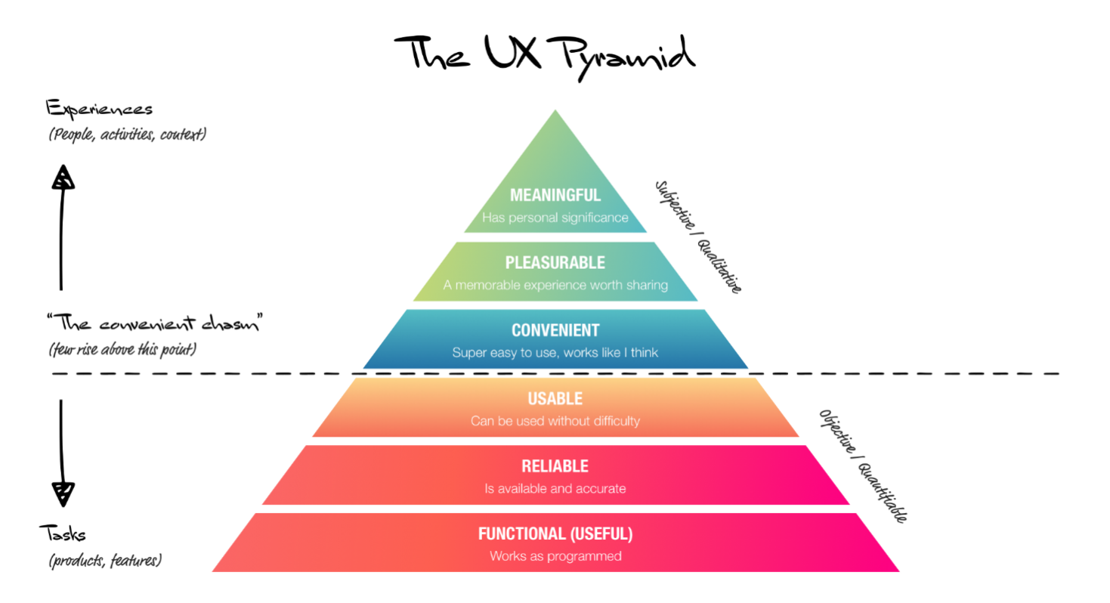

Slide 2
Level 1: Functional Does it work?
Characteristics:
No bugs, errors and outages
Uses current technologies (doesn’t rely on old technologies like Flash that don’t work on phones or tablets)
It has some purpose; someone has a need for it
Includes all key features
Works in all modern browsers
Passes basic accessibility

Slide 3
Level 2: Reliable Is it available and accurate?
Characteristics:
Loads in reasonable time, even in peak periods
Content is current and accurate
Data is clean and reliable
Password resets are sent/received promptly
It can be used effectively on mobile devices and standard device types

Slide 4
Level 3: Usable Can it be used without difficulty?
Characteristics
Users don’t get lost or confused
Users can easily find the content or products they are interested in
The site doesn’t rely on constant help messages or long instruction manuals
It has a short learning curve
Users don’t rely on ‘hacks’ or workarounds to use it
Call centres aren’t swamped with basic enquiries
Meets basic UX heuristics and best practice

Slide 5
Level 4: Usable Can it be used without difficulty?
Characteristics
Users don’t get lost or confused
Users can easily find the content or products they are interested in
The site doesn’t rely on constant help messages or long instruction manuals
It has a short learning curve
Users don’t rely on ‘hacks’ or workarounds to use it
Call centres aren’t swamped with basic enquiries
Meets basic UX heuristics and best practice

Slide 6
Level 5: Pleasurable Is it an enjoyable experience that’s worth sharing?
Characteristics
Users invest themselves into it
Users promote, share and evangelise it
It becomes part of the user’s regular routine

Slide 7
Level 6: Meaningful Does it have personal or social significance?
Characteristics
Users it brings meaning to their life
Diagnosing and solving UX issues
There are three main strategies for improving the UX of a design or system.

Slide 8
Elements of UX Design
When you want to make or buy something while on a website, you make decisions. Analysing the key elements of UX, you will better understand how these decisions are made. By meeting the needs of users, we motivate them to stay on the website, engage in interaction and be more satisfied.
There are five key elements of UX.
All 5 steps are dependent on each other and the whole process goes from bottom to top.

Slide 9
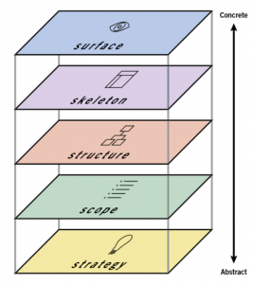

Slide 10
The strategy defines the reason why an application or product exists, why you are doing the whole business, who you are doing and why people would use it.
The main goal here is to define the needs of users and business goals.
This can be done through a strategic research where potential users would be interviewed on one side, and business needs would be adjusted on the other

Slide 11
Volume
The scope defines the functional and content requirements. What features and content should contain the product. Requirements should meet strategic goals.
Functional requirements – related to the functioning of the entire side, as certain parts work together.
These are the characteristics that the user needs to store to achieve a specific goal. Content requirements – the information we need to give value to what we do (text, images, video).

Slide 12
Structure
The structure defines the user’s interaction with the product, the behaviour of the whole system, how it is organized, and how much it should be displayed at a given moment.
There are two structural components: interactive design & information architecture. Interactive design – when functional features are already defined, defines the user’s relationship with the product as a system that needs to respond to given user requests.

Slide 13
Excellent Interactive design:
Helps users meet their goals;
Has effective interactivity and functionality (what the user can do);
It informs the user about changing conditions while on the page (file has been saved, feedback when the wrong email has been entered, etc.);
Prevents errors when the application requires confirmation from the user for a potentially harmful effect (eg deletion).

Slide 14
The skeleton determines the visual form of the screen and presents all the elements that need to be interacted. Shows how the user moves through information and how the information is presented to be clear, effective, and obvious. Wireframes are widely used to create a visual format.
It is actually a static diagram that presents the visual format of the product, which includes content, navigation, and all forms of interaction. The skeleton is divided into three parts: Design of the interface, design of navigation and information design.

Slide 15
Interface design – presenting and editing elements so they can act with the functionality of the application; Navigation Design – the way of navigating through the information; Information Design – presentation of the information in an easily understandable way.
The skeleton should answer the following questions:
What visual forms should be presented on the screen? How can interactions be presented and divided? How can a user move around the site or application? How can the content be clearly presented?

Slide 16
VISUAL DESIGN PRINCIPLES
Visual-design principles inform us how design elements such as line, shape, color, grid, or space go together to create well-rounded and thoughtful visuals.
This article defines 5 visual-design principles that impact UX:
Scale
Visual hierarchy
Balance
Contrast
Gestalt

Slide 17
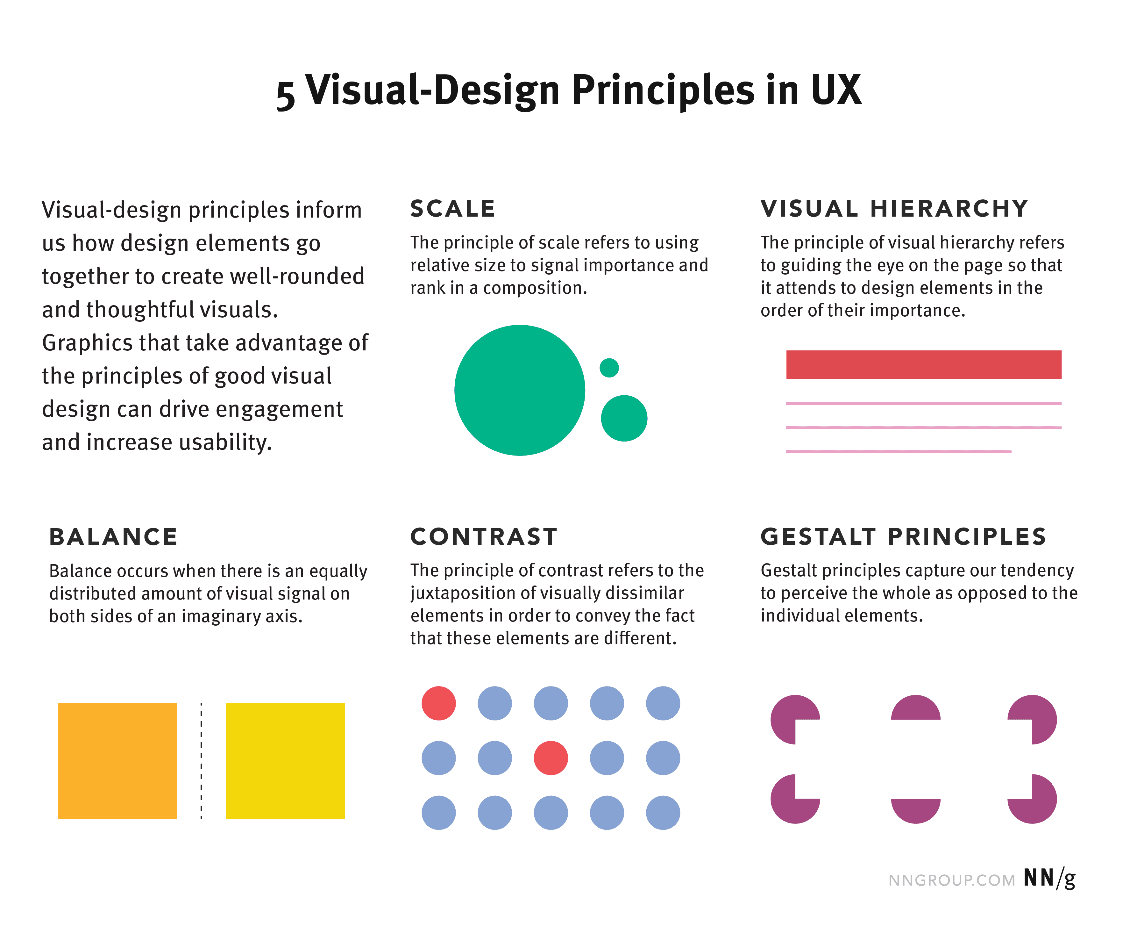

Slide 18
1. Scale
This principle is commonly used: almost every good visual design takes advantage of it.
Definition: The principle of scale refers to using relative size to signal importance and rank in a composition.
In other words, when this principle is used properly, the most important elements in a design are bigger than the ones that are less important. The reason behind this principle is simple: when something is big, it’s more likely to be noticed.
A visually pleasing design generally uses no more than 3 different sizes. Having a range of differently sized elements will not only create variety within your layout, but it will also establish a visual hierarchy (see next principle) on the page. Be sure to emphasize the most important aspect of your design by making them biggest.

Slide 19
.
2. Visual Hierarchy
A layout with a good visual hierarchy will be easily understood by your users.
Definition: The principle of visual hierarchy refers to guiding the eye on the page so that it attends to different design elements in the order of their importance.
Visual hierarchy can be implemented through variations in scale, value, color, spacing, placement, and a variety of other signals.
Visual hierarchy controls the delivery of the experience. If you have a hard time figuring out where to look on a page, it’s more than likely that its layout is missing a clear visual hierarchy.

Slide 20
3. Balance
Balance is like a seesaw: instead of weight, you are balancing design elements.
Definition: The principle of balance refers to a satisfying arrangement or proportion of design elements. Balance occurs when there is an equally distributed (but not necessarily symmetrical) amount of visual signal on both sides of an imaginary axis going through the middle of the screen. This axis is often vertical but can also be horizontal.

Slide 21
4.Contrast
This is another commonly used principle that makes certain parts of your design stand out to your users.
Definition: The principle of contrast refers to the juxtaposition of visually dissimilar elements in order to convey the fact that these elements are different (e.g., belong in different categories, have different functions, behave differently).
In other words, contrast provides the eye with a noticeable difference (e.g., in size or color) between two objects (or between two sets of objects) in order to emphasize that they are distinct.
The principle of contrast is often applied through color. For example, red is frequently used in UI designs, especially on iOS, to signify deleting. The bright color signals that a red element is different from the rest

Slide 22
5. Gestalt Principles
These are a set of principles that were established in the early twentieth century by the Gestalt psychologists. They capture how humans make sense of images.
Definition: Gestalt principles explain how humans simplify and organize complex images that consist of many elements, by subconsciously arranging the parts into an organized system that creates a whole, rather than interpreting them as a series of disparate elements. In other words, Gestalt principles capture our tendency to perceive the whole as opposed to the individual elements

